Slide 1
BATTLE OF NEIGHBORHOODS
(choosing the best Apartment area in manhattan)
By
REVANTH.MADAMALA

Slide 2
Introduction
1.1 Scenario and Background:I am a data scientist currently residing in INdia. I currently live In Hyderabad therefore I have access to good public transportation to work. Likewise, I enjoy many amenities in the neighborhood , such as international cuisine restaurants, cafes, food shops and entertainment. I have been offered a great opportunity to work in Manhattan, NY. Although, I am very excited about it, I am a bit stress toward the process to secure a comparable place to live in Manhattan.
1.2 Problem to be resolved:The challenge to resolve is being able to find a rental apartment unit in Manhattan NY that offers similar characteristics and benefits to my current situation. Therefore, in order to set a basis for comparison, I want to find a rental unit subject to the following conditions:
Apartment with min 2 bedrooms with monthly rent not to exceed US$7000/month
Unit located within walking distance (<=1.0 mile, 1.6 km) from a subway metro station in Manhattan
Area with amenities and venues similar to the ones described for current location ( See item 2.1)
1.3 Interested Audience: I believe this is a relevant project for a person or entity considering moving to a major city in Europe, US or Asia, since the approach and methodologies used here are applicable in all cases. The use of FourSquare data and mapping techniques combined with data analysis will help resolve the key questions arisen. Lastly, this project is a good practical case toward the development of Data Science skills.

Slide 3
Data Section
Description of the data and its sources that will be used to solve the problem
2.1 Data of Current Situation:I Currently reside in the neighborhood of Srinagar colony,Hyderabad,India. I use Foursquare to identify the venues around the area of residence which are then shown in the Hyderabad map shown in methodology and execution in section 3.0 . It serves as a reference for comparison with the desired future location in Manhattan NY
2.2 Data Required to resolve the problem:In order to make a good choice of a similar apartment in Manhattan NY, the following data is required: List/Information on neighborhoods from Manhattan with their Geodata ( latitude and longitude. List/Information about the subway metro stations in Manhattan with geodata. Listed apartments for rent in Manhattan area with descriptions ( how many beds, price, location, address) Venues and amenities in the Manhattan neighborhoods.
A list of Manhattan subway metro stops was compiled in Numbers and it was completed with wikipedia data ( https://en.wikipedia.org/wiki/List_of_New_York_City_Subway_stations_in_Manhattan) and information from NY Transit authority and Google maps (https://www.google.com/maps/search/manhattan+subway+metro+stations/@40.7837297,-74.1033043,11z/data=!3m1!4b1) for a final consolidated list of subway stops names and their address. The geolocation was obtained via an algorithm using Nominatim. Details will be shown in the execution of methodology in section 3.0. The subway csv file is ''MH_subway.csv'" and the data structure is: mhsub.tail():

Slide 4
Contd..
A list of places for rent was collected by web-browsing real estate companies in Manhattan : http://www.rentmanhattan.com/index.cfm?page=search&state=results https://www.nestpick.com/search?city=new-york&page=1&order=relevance&district=manhattan&gclid=CjwKCAiAjNjgBRAgEiwAGLlf2hkP3A-cPxjZYkURqQEswQK2jKQEpv_MvKcrIhRWRzNkc_r-fGi0lxoCA7cQAvD_BwE&type=apartment&display=list https://www.realtor.com/apartments/Manhattan_NY A csv file was compiled with the rental place that indicated: areas of Manhattan, address, number of beds, area and monthly rental price.it was possible to determine the latitude and longitude for the subway metro locations as well as for the geodata for each rental place listed
"Great_circle" function from geolocator was used to calculate distances between two points , as in the case to calculate average rent price for units around each subway station and at 1.6 km radius. Foursquare is used to find the avenues at Manhattan neighborhoods in general and a cluster is created to later be able to search for the venues depending of the location shown.

Slide 5
Methodology section
The strategy is based on mapping the above described data in section 2.0, in order to facilitate the choice of at least two candidate places for rent. The choice is made based on the demands imposed : location near a subway, rental price and similar venues to hyderabad
The processing of these DATA and its mapping will allow to answer the key questions to make a decision:
what is the cost of available rental places that meet the demands? what is the cost of rent around a mile radius from each subway metro station? what is the area of Manhattan with best rental pricing that meets criteria established? What is the distance from workplace ( Park Ave and 53 rd St) and the tentative future rental home? What are the venues of the two best places to live? How the prices compare? How venues distribute among Manhattan neighborhoods and around metro stations? Are there tradeoffs between size and price and location? Any other interesting statistical data findings of the real estate and overall data.

Slide 6
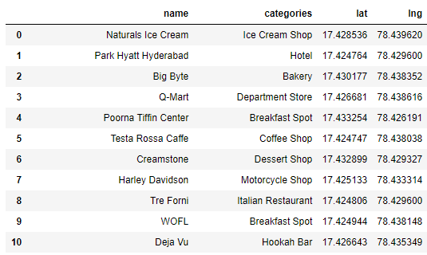
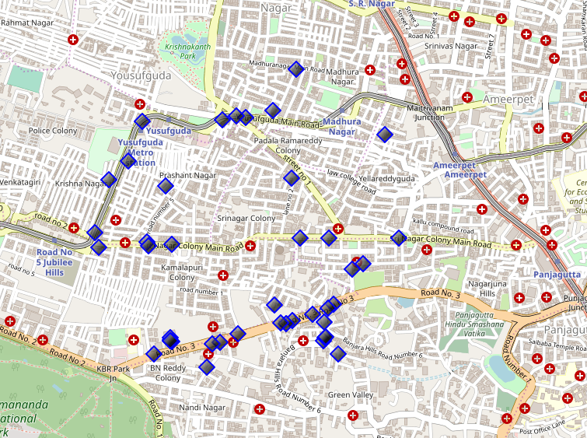
Data from Hyderabad location
Locations from hyderabad (list and Map)

Slide 7
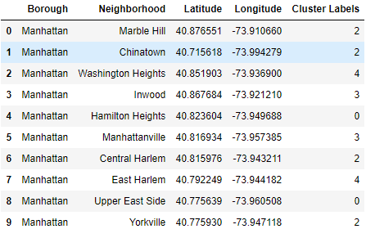
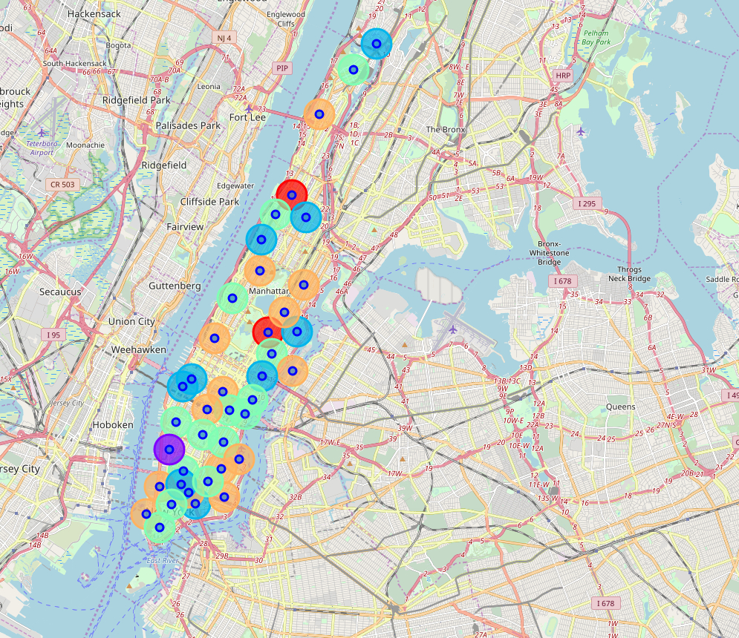
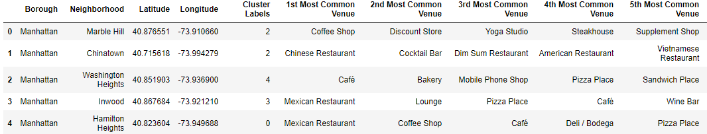
Manhattan Neighborhood analysis
Map obtained after
clustering
Neighborhood data and top 5 locations

Slide 8
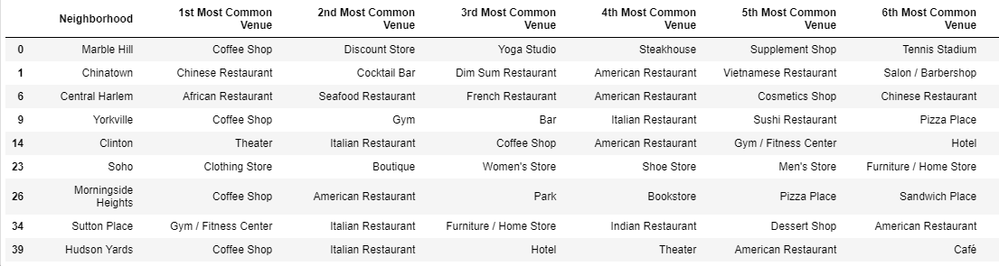
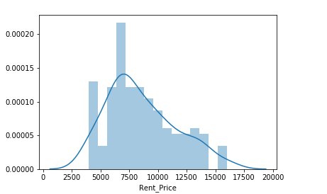
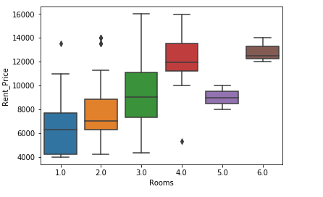
Examining Cluster 2(pricings and venues)

Slide 9
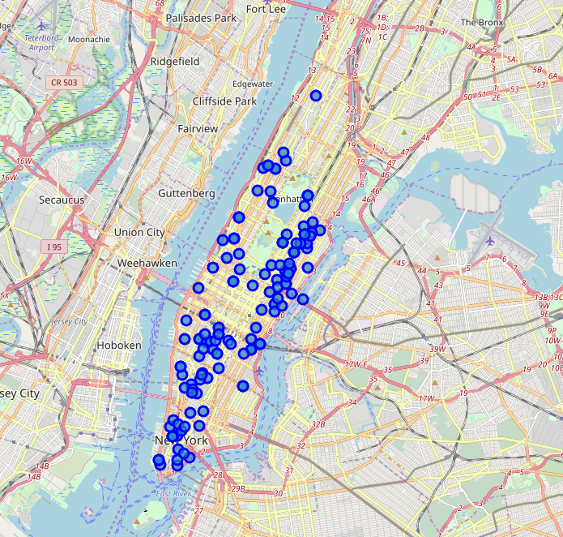
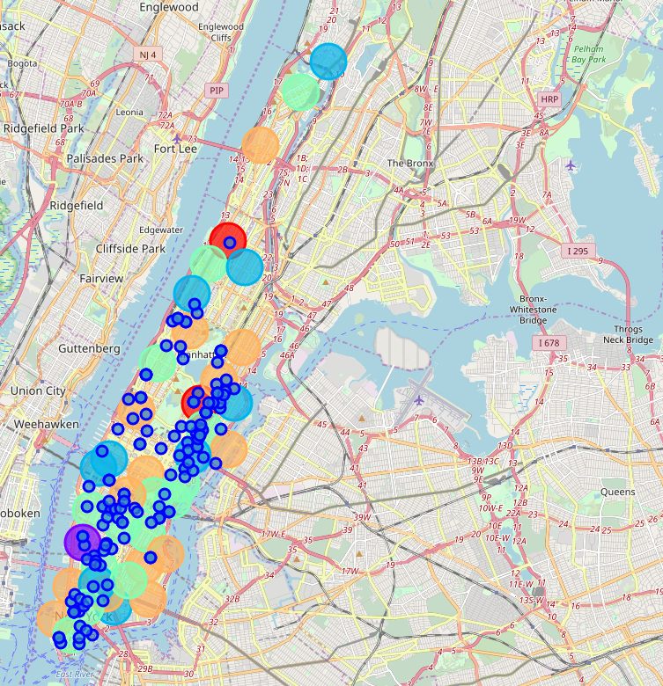
Maps corresponding to previous data(cluster-2)

Slide 10
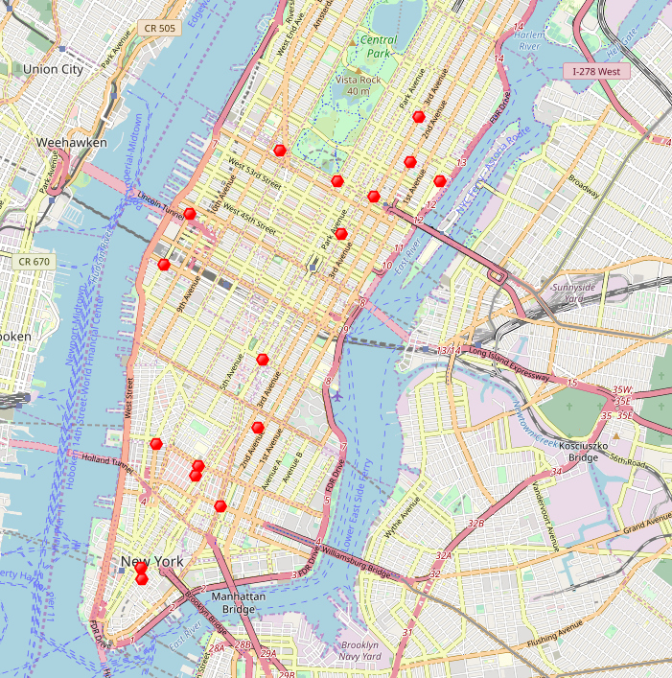
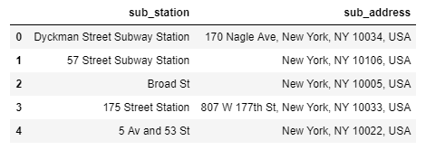
Metro locations

Slide 11
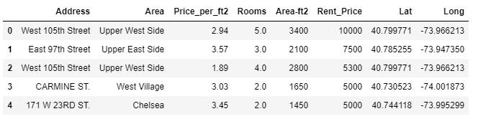
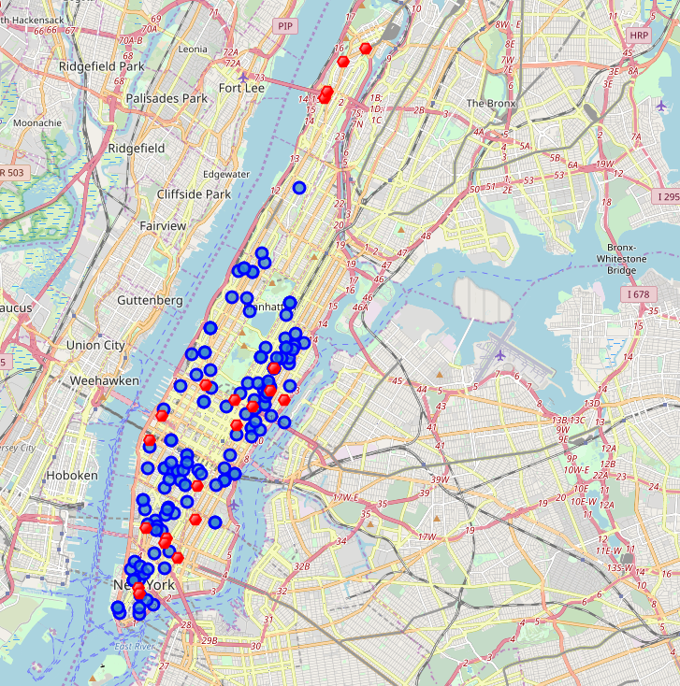
Locations near Metro

Slide 12
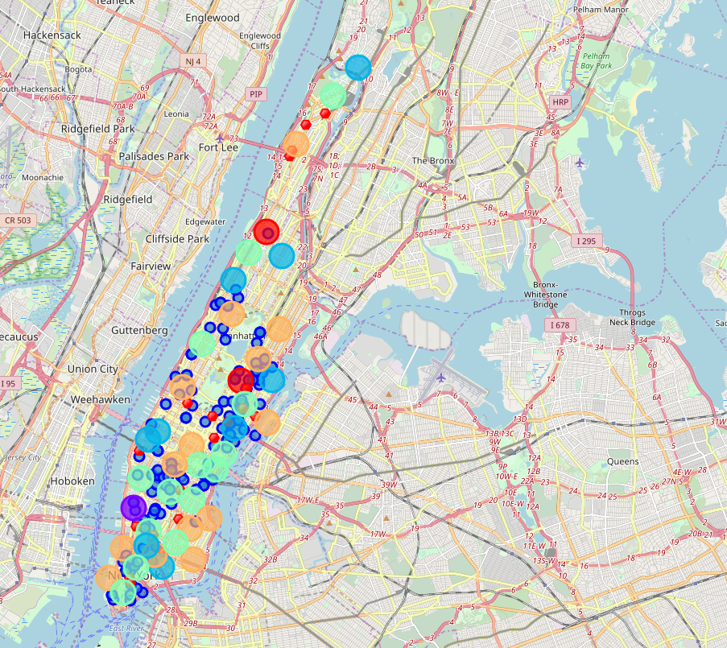
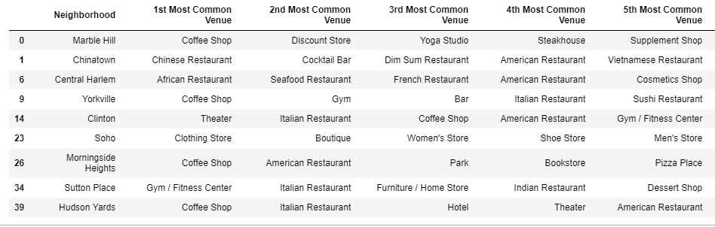
Results :ONE CONSOLIDATE MAP
Red dots are Subway stations, Blue dots are apartments available for rent, Bubbles are the clusters of venues
The above consolidate map was used to explore options. After examining, I have chosen two locations that meet the requirements which will assess to make a choice. Apartment 1: 305 East 63rd Street in the Sutton Place Neighborhood and near 'subway 59th Street' station, Cluster # 2 Monthly rent : 7500 Dollars
Apartment 2: 19 Dutch Street in the Financial District Neighborhood and near 'Fulton Street Subway' station, Cluster # 3 Monthly rent : 6935 Dollars

